Slide 1
Micro Campaigns & Creating Your Fundraising Story
Matt Wasserman
matt@makephilanthropywork.com
Kaye Taavialma
kaye@makephilanthropywork.com

Slide 2
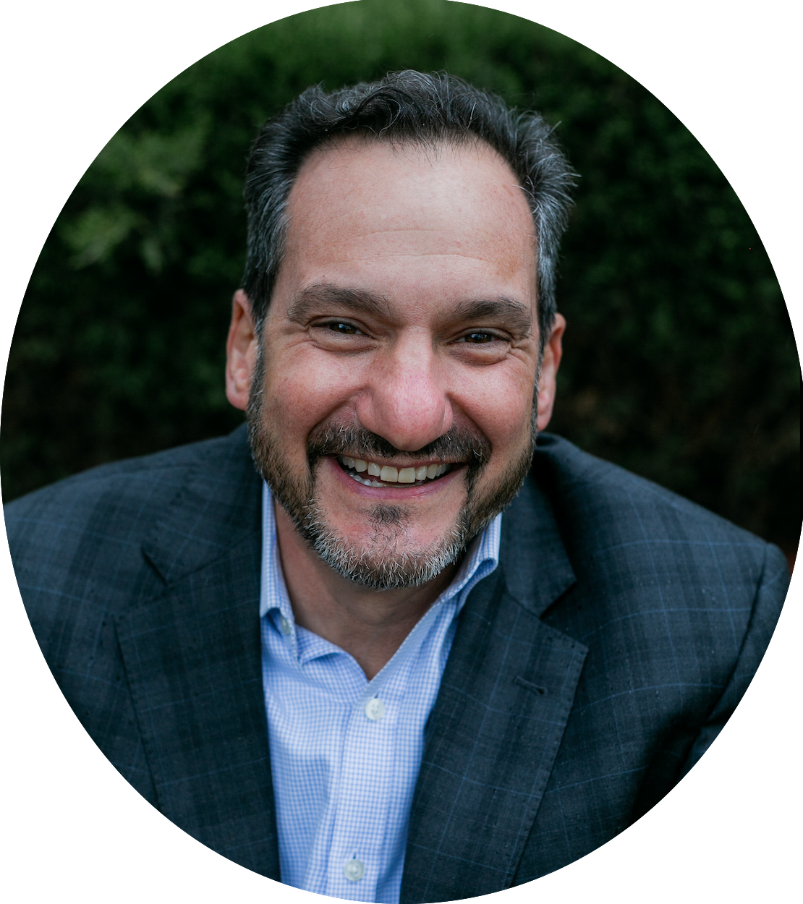


Matt Wasserman, Principal and Founder
Founder & Principal of Make Philanthropy Work
Fundraising for over 25 years
Art Museum, CU Denver
Spending time with the family
Skiing, hiking, and camping
matthew-wasserman
@immattwasserman

Slide 3

Kaye Taavialma, Senior Consultant
Former charter school leader
Secured BEST Grant for $15.5M
Raised > $300K toward match
Education & nonprofit consultant
Board and leader coaching
Bleacher-bound mom & actor
kaye-taavialma
www.kayescoaching.com

Slide 4
What We Do
Provide a suite of services that transform, impact, and advance missions
Coach leadership and motivate staff to raise hundreds of millions of dollars from donors of every background and interest
Develop services specifically designed to guide charter schools in unlocking their full fundraising potential and create sustainable fundraising practices
Offer fundraising services and solutions for charter schools that are grounded in fundraising best practices and precisely geared to support school leaders and charter boards

Slide 5







Our Clients

Slide 6
Most donors say that knowing the IMPACT of their gift is more important than “recognition”

Slide 7
Agenda
Building a Micro Campaign
Importance of the impact idea/story
Developing the story
Work on your fundraising story

Slide 8
What is a Micro Campaign?
What it is
A 30-90 day multi- channel campaign
Fund a specific need/opportunity
Digitally based
Inspire your base
What it includes
Inspiring Story
Leverage your base
Matching gifts
Awards
Constant communication: email, mail, social media, automated voicemail

Slide 9
Micro Campaign Key To Success
Select Focus Area | What are you raising money for?
Set Goal Amount | How much are you raising? Realistic Always can increase
Select Platform | Community Funded 4AGoodCause Qgiv GiveLively
Budget | Cost of platform Email Social advertising Voice mail messaging Mailing
Formalize Team | Who is going to help with this work and what role will they play?
Build a Timeline | At least 30 days out

Slide 10
Develop Case/Story | Make your case! Write three (no more than five) paragraphs that tell audiences why your cause matters and how giving will change things.
Engage Partners | Who are your biggest cheerleaders? Who are your corporate connections/partners who can support? Any benefactors/silent givers?
Identify Influencers | Who are people with a big reach on social media? Anyone on your team have connections with community leaders or even celebrities?
Identify Stories & Storytellers | Who is this project going to impact?
Finalize outreach channels to use | Social / Advertising Newsletter Email Mail Phone Event Volunteer outreach Text to Give Geo Fence Website retarget

Slide 11
Fundraising Story Creation:
Donors align their investment to the impact it will create
What is the problem you are solving?
What will happen if nothing is done?
What would the future look like if the problem is solved?
How does your organization solve the problem?
Provide the evidence
…Join us in solving that problem
Based on The Greatest Sales Dec I’ve Ever Seen:
https://medium.com/the-mission/the-greatest-sales-deck-ive-ever-seen-4f4ef3391ba0

Slide 12

1. What is the problem you’re solving?
Don’t talk about your school
Talk about the problem, challenge, issue that your school solves
The pain in the community that you alleviate
Use a story - real life example
Use data/stats

Slide 13
2. What will happen if nothing is done?
What will happen directly to the students/community you serve if nothing is done (if you not there)
How they will be effected - what will life be like next month, next year, in five years
What is the consequence to society - economically, health (physical /mental), culturally
Use a story - real life example
Use data/stats
Don’t talk about your school

Slide 14

3. What would the future look like?
Tease the future possibility
Don’t tell what your school does yet
It doesn’t have to be like this… It could be like…
Tell a story
Use data/stats

Slide 15
4. How does your School solve the problem?
What does your School do directly to solve the problem?
This is not necessarily your mission or vision
What are you doing on the frontlines of the issue to solve or make better?
Tell a story – a real life example
No stats or data yet

Slide 16

5. Provide the evidence
Tell the success story of your school
Stay away from saying you’re the “only” or the “biggest”
Provide data, stats, analysis

Slide 17
6. Join us!
The Close
How the donor can join you in solving the problem
Invite your reader/viewer to participate in your movement

Slide 18
Bringing it all together.
Are you ready to build your micro campaign story?

Slide 19
Get the download
Access this presentation and your free micro campaign building checklist at:
info.makephilanthropywork.com/chartermicrocampaign
*Make Philanthropy Work owns this content. If you’d like to discuss opportunities to share with your network, please contact matt@makephilanthropywork.com

Slide 20
Questions?
Matt Wasserman
Kaye Taavialma
matt@makephilanthropywork.com
makephilanthropywork.com
matthew-wasserman
@immattwasserman
kaye@makephilanthropywork.com
kayescoaching.com
kaye-taavialma

